Slide 1
Biography
Ashwini Yermal Shanbhogue
Ashwini has a Master’s degree in Biochemistry. While working as a Lab Research Scientist she discovered that as much as she enjoyed generating data, she enjoyed decoding it more. She is now pivoting to pursue her true passion- data analysis.

Slide 2
RWD (OMOP) to SDTM (CDISC)
A primer for your ETL journey

Slide 3
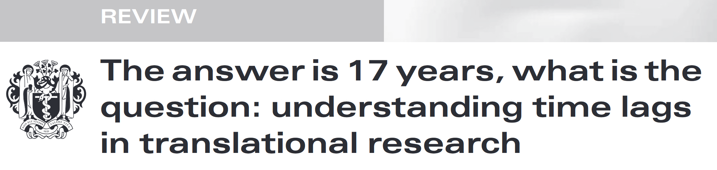

RWD and RWE- What and Why?
RWD
EHRs
Other (mobile devices)
Medical claims, Billing data
Product and Disease registries
Patient-generated data
https://www.ncbi.nlm.nih.gov/pmc/articles/PMC3241518/pdf/JRSM-11-0180.pdf
RWE
https://www.fda.gov/media/120060/download

Slide 4
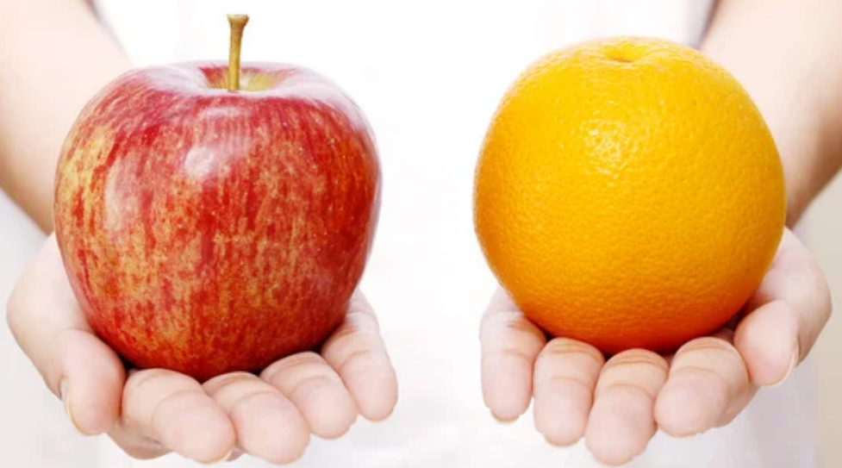
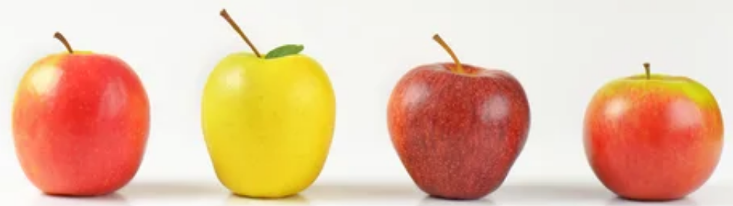
COMMON DATA MODEL (CDM)
RWD 1
RWD 2
i2b2/ ACT
PCORnet
Sentinel
OMOP

Slide 5
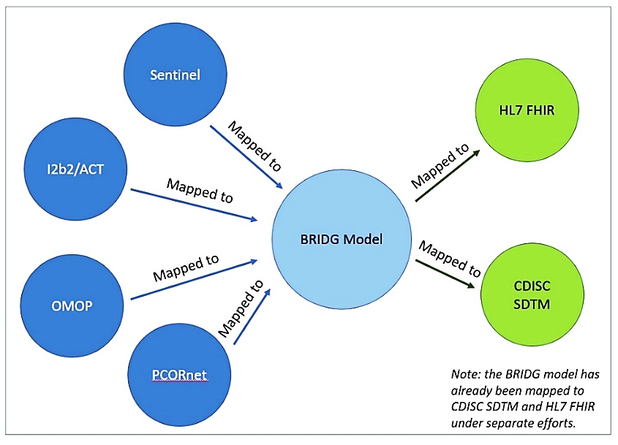
CDMH and BRIDG
CDMH mapped CDMs to BRIDG
BRIDG seeks harmonization of semantics and semantic interoperability
BRIDG was a data integration/ mapping solution for CDMH
This use case utilized for my ETL

Slide 6
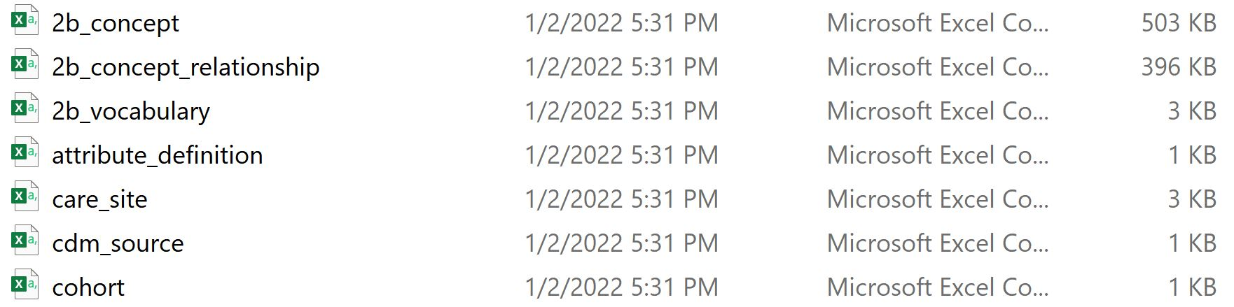

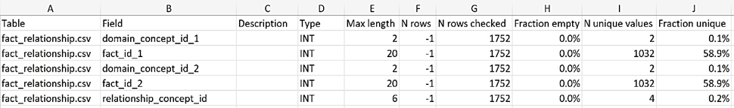
MIMIC IV data set in OMOP CDM
Demo data set of 100 patients
Critical care units of BIDMC, Boston, MA between 2008 and 2019
Data available in the form of csv files
Prepared for
ETL using
White Rabbit
This Photo by Unknown Author is licensed under CC BY

Slide 7
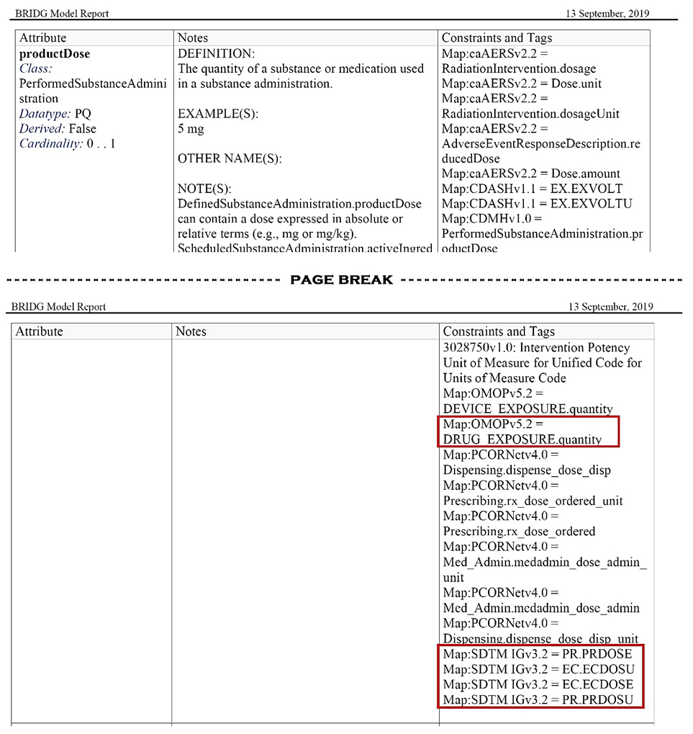
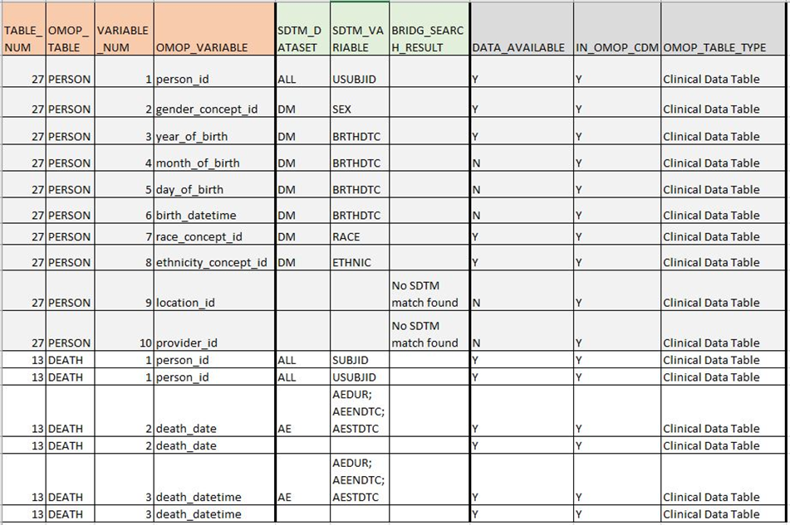
Mapping with BRIDG
A
X
B
Initial mapping
BRIDG Release 5.3.1

Slide 8
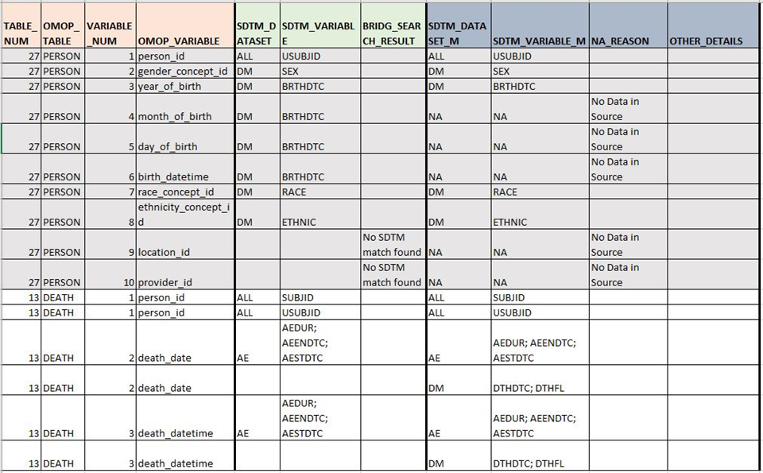
Manual Curation
Final mapping

Slide 9
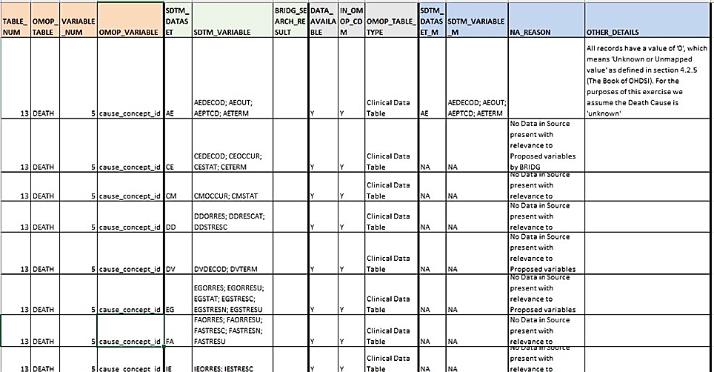
Challenges
Manual curation is required

Slide 10
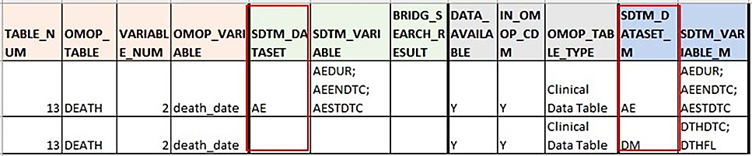
Challenges
Uncaptured mapping

Slide 11
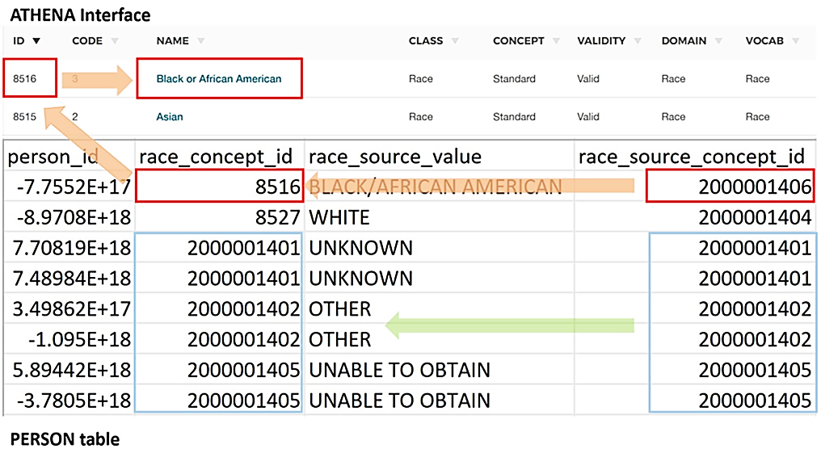
Challenges
Controlled terminologies

Slide 12
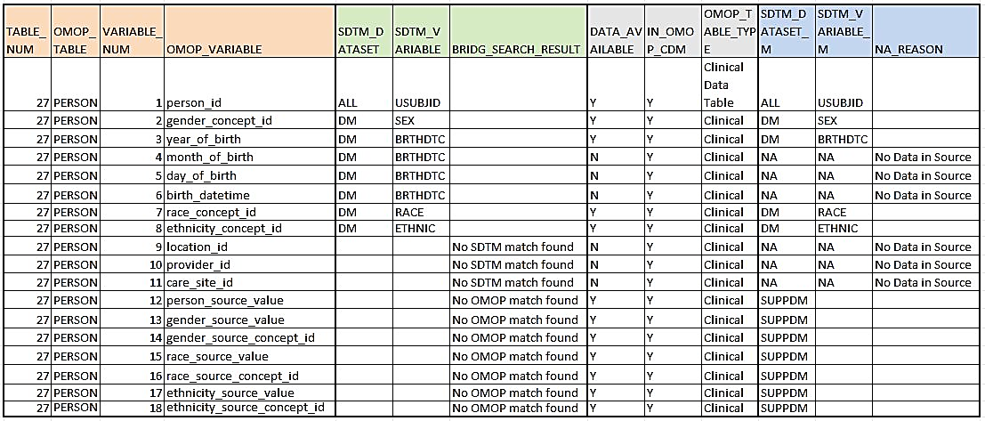
Challenges
Non- standard variables
Non- availability of data in some OMOP tables

Slide 13
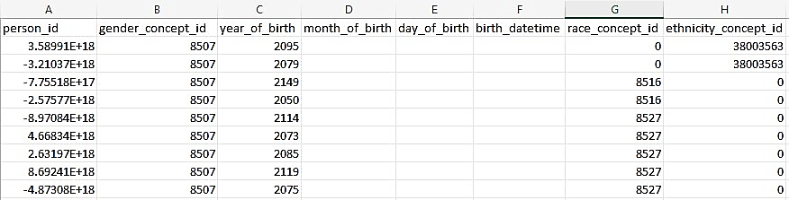
Challenges
De- identification of data

Slide 14
Conclusion
In my paper, I have elucidated the process of mapping MIMIC IV v0.9 demo data in OMOP CDM v5.3.1 to CDISC SDTM v3.2 using the CDMH project as a jumping-off point, documented several associated challenges and provided suggestions to address some of these challenges. This document, that shows the end-to-end mapping of RWD to SDTM in a stepwise manner, could serve as a primer to the process of ETL.

Slide 15
References
Framework for FDA’s Real World Evidence Program. (2021, December). FDA. https://www.fda.gov/media/120060/download
Observational Health Data Sciences and Informatics. (2021, January 11). The Book of OHDSI. Www.Ohdsi.Org. Retrieved April 4, 2022, from https://ohdsi.github.io/TheBookOfOhdsi/
Common Data Model Harmonization (CDMH) and Open Standards for Evidence Generation. (2020, August). FDA, NIH, Office of the National Coordinator for Health Information Technology (ONC). https://aspe.hhs.gov/sites/default/files/private/pdf/259016/CDMH-Final-Report-14August2020.pdf
BRIDG | Biomedical Research Integrated Domain Group. (n.d.). Https://Bridgmodel.Nci.Nih.Gov/. Retrieved April 7, 2022, from https://bridgmodel.nci.nih.gov/
Kallfelz, M., Tsvetkova, A., Pollard, T., Kwong, M., Lipori, G., Huser, V., Osborn, J., Hao, S., & Williams, A. (2021). MIMIC-IV demo data in the OMOP Common Data Model (version 0.9). PhysioNet. https://doi.org/10.13026/p1f5-7x35.
Johnson, A., Bulgarelli, L., Pollard, T., Horng, S., Celi, L. A., & Mark, R. (2021). MIMIC-IV (version 1.0). PhysioNet. https://doi.org/10.13026/s6n6-xd98

Slide 16
Acknowledgements
Bhargav Koduru for providing valuable input in understanding the process of SDTM mapping and transformation and for his support and guidance in reviewing the paper
Dr. Laura K. Wiley and Dr. Michael G. Kahn, University of Colorado for their excellent course, ‘Clinical Data Science’ on Coursera which introduced me to the concepts of Real World Data and Common Data Models.

Slide 17
THANK YOU

Slide 18
Ashwini Yermal Shanbhogue
ash23shan@yahoo.com
www.linkedin.com/in/ashwini-y-shanbhogue-51121b21/
https://github.com/ash23shan
GitHub:

